Slide 1
Families Experiencing Loss, Grief and Trauma: Resources and Help when Tragedy Strikes
H. Norman Wright

Slide 2
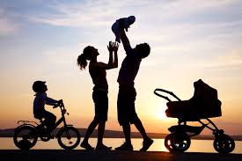

Slide 3
Loss and Trauma in the Family
It’s usually not one person impacted by a death but an entire family unit. Unique problems arise. The balance of the family system is disrupted. What if a family member is terminal?

Slide 4
Loss and Trauma in the Family
Each member of the family unit differs in his or her response and even acceptance of the news. Some members will respond well to the needs of the dying person, while others would rather not acknowledge the impending death.

Slide 5
Loss and Trauma in the Family
What if a parent dies? A child? A grandparent? Each family member’s grief is unique. You will become aware of this quickly, and the fact will stretch you and your ability to assist them. No matter whether you meet with a family of three or four or a group of eight or ten, each one will respond in a unique way, even though they have all been exposed to the same loss.

Slide 6
Loss and Trauma in the Family
But have they really been exposed to the same loss? Perhaps, but perhaps not. It could be that you’ve already experienced this in some of your own grief events. Each person’s grief response is affected by numerous factors, and by its DNA. It helps to look at a mourner and realize all that has come into play.

Slide 7
The Family Unit
Part of the difficulty will be family differences to the event.
“It doesn’t help to talk about it.”
“You can talk about it, but not with me.”
“Let’s just move on.”
“We’re doing fine, but thanks for asking.”
“If your not sharing feelings you’re not responding in a healthy way.”
“Let’s let others help us.”

Slide 8
The Family Unit
When a family member is traumatized the family balance is disrupted. There’s a hole in the fabric of the family, but not everyone understands this. If one member is traumatized so are the others.

Slide 9
Terminal
Illness

Slide 10
The Family Unit
Some of the unique problems to consider in the family system are:
1. How close was each family member to the dying person? What was the quality of their relationship or level of attachment?
2. What is the grieving pattern of each person and what does each know about grief?
3. To what extent does each person want to be involved with the dying person at this time?

Slide 11
The Family Unit
4. How does the expression of grief affect the grief of other family members?
5. How will the family handle “after death” issues if there are differences such as what type of funeral, disposal of remains, type of service, disposal and disbursement of clothing and personal affects, photographs shown or not shown, holidays, anniversaries, etc.
6. What are the specific reasons for the grief of each family member?

Slide 12
Let’s distinguish between Loss,
Crisis, and Trauma
Loss produces an ache, an emptiness, a sadness.
Crisis throws us off balance and into a state of shock, panic and uncertainty.
Trauma is a wounding. It overwhelms our senses and rewires our brain.

Slide 13
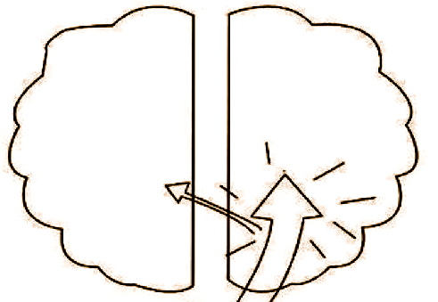
What happens to the brain during loss, crisis or trauma?
L
R
Loss
Crisis
Trauma

Slide 14
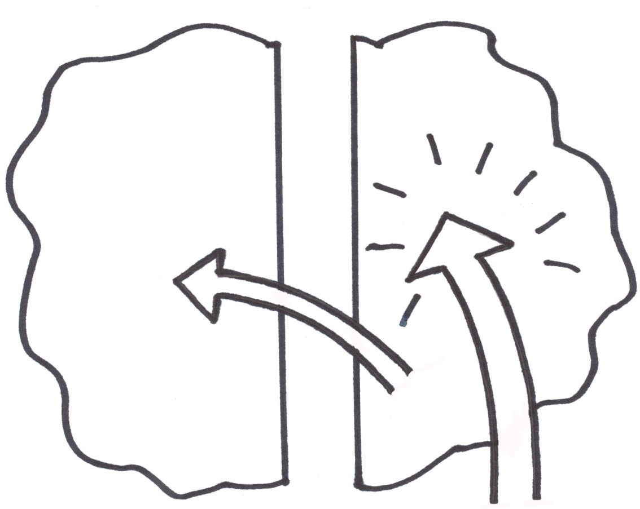
L
R
Numbness
Stunned
Shock
Disorientation
Loss
Significant Loss or Crisis
Trauma

Slide 15
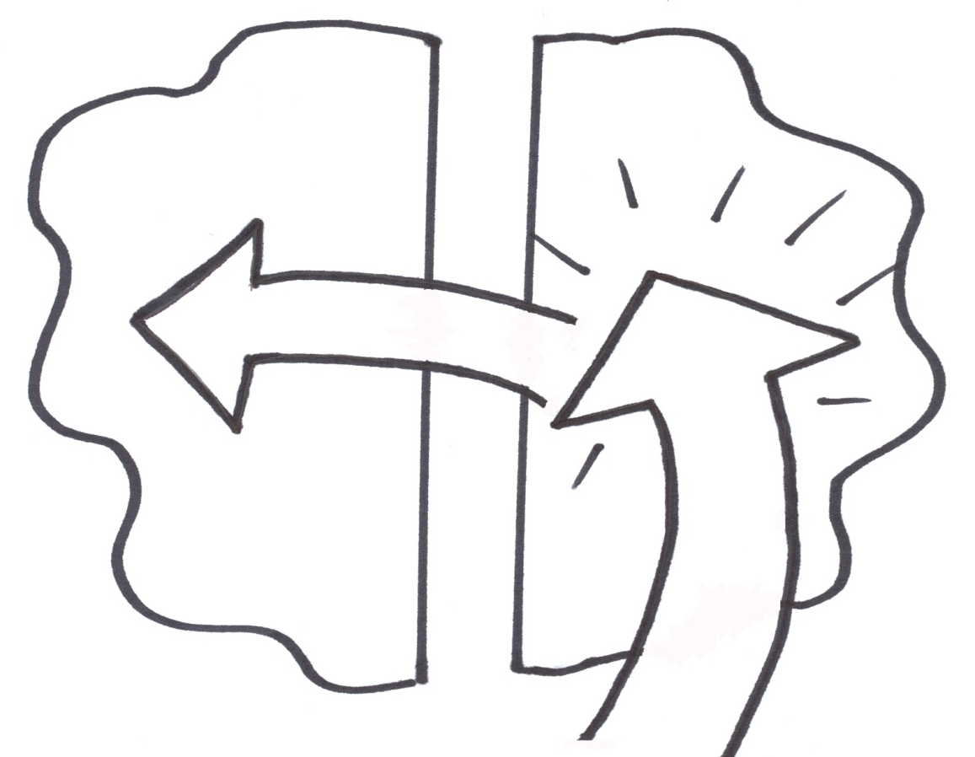
L
R
Trauma
May change brain chemistry. Memory deficit. Damage
to brain structure. Trauma separates the left and the right side of the brain.
Floods
It Overwhelms
Loss
Crisis
Trauma

Slide 16
The Losses of Life
1. Real or Material
First loss as a child
Many are replaceable which could mask the grief reaction

Slide 17
The Losses of Life
2. Abstract
—Love —Hope —Ambition —Control – Loss of Face
3. Imagined or Perceived
We think…the other no longer loves us
Elderly woman complains children have abandoned her – Expectations

Slide 18
Perceived Loss
We also grieve for something that we never had and never will have. This represents our perceived failure to bond.
Examples are the relationships never to be had with an alcoholic mother or a brother who died in a war, an education never acquired, the dream of a lifestyle never achieved.

Slide 19
Perceived Loss
A company’s financial reverses and the resultant changes often contribute directly to the loss of dreams not only for the employees but also for the families affected.

Slide 20
The Losses of Life
4. Relationship Loss
The end of an opportunity to relate—death, divorce, moving, end of friendship

Slide 21
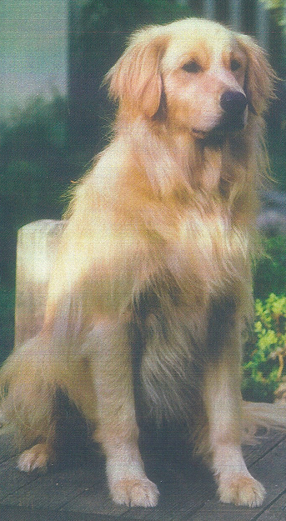

Slide 22
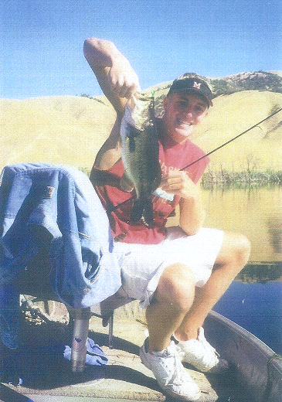

Slide 23
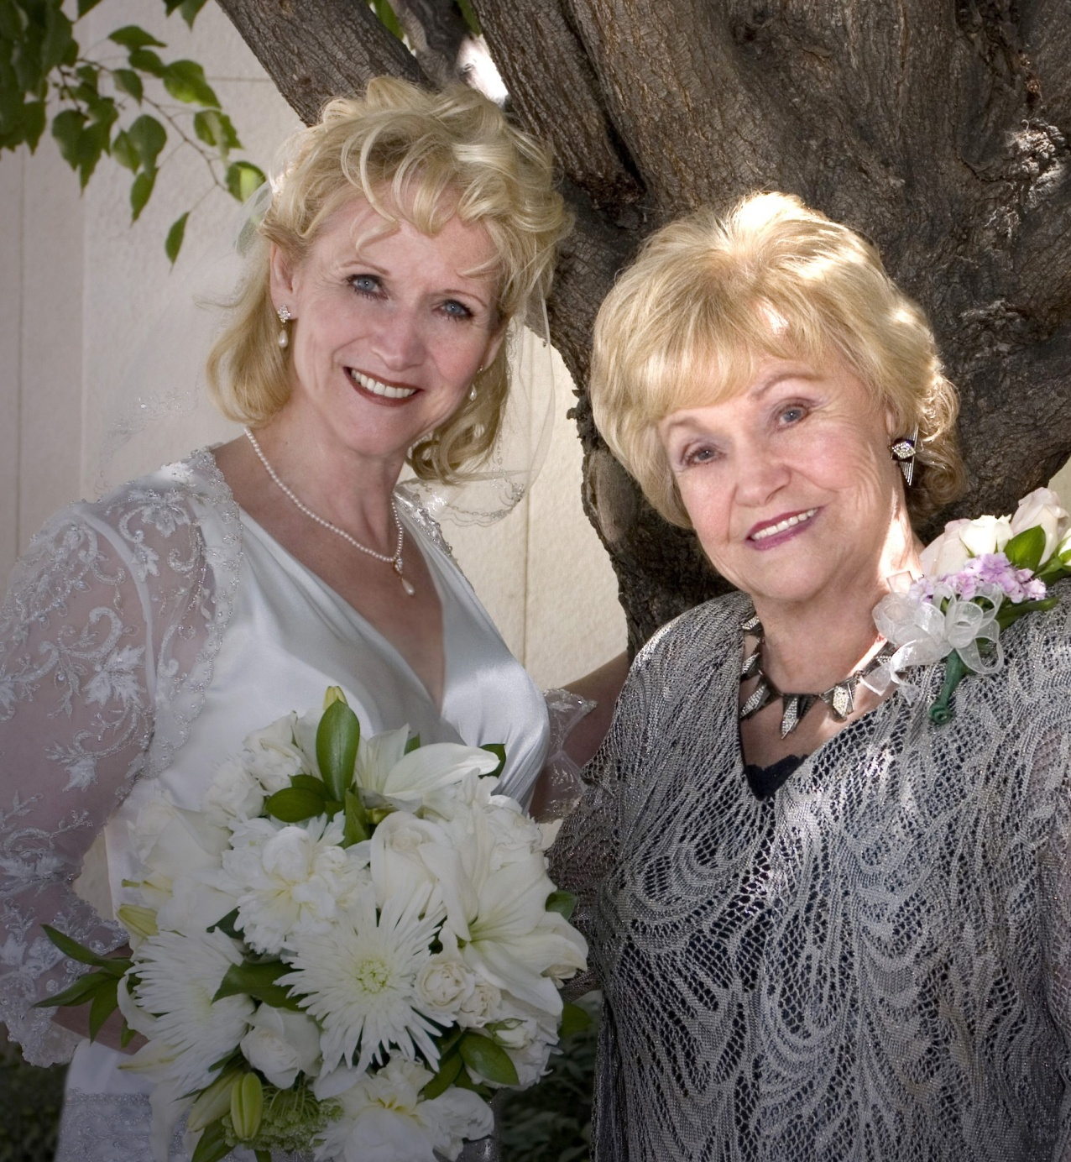

Slide 24
The Losses of Life
5. Intrapsychic Loss
Losing an image of oneself
Losing what “might have been”
Death of a dream
Loss of Face - Shame

Slide 25
The Losses of Life
6. Functional Loss
Muscular or neurological function – sight, hearing, coordination, body part, memory,
Diagnosis
Disability – Chronic Illness

Slide 26
The Senility Prayer
God grant me the senility
To forget the people
I never liked anyway,
The good fortune to run into the ones I do,
And the eyesight to tell the difference.

Slide 27
The Losses of Life
7. Role Loss
Retirement, transfer, promoted, demoted, graduation
8. Systemic Loss – Child leaves home; fellow-worker;
family from your church; pastor leaves

Slide 28
The Losses of Life
9. Threatened Loss
Biopsy “I’m thinking of divorcing you.” downscaling, lawsuit, terrorism, hurricane, tornado, floods

Slide 29
The Losses of Life
10. Ambiguous – 2 Main Types
Variations
Deployment, adoptee’s search for parents, MIA, The World Trade Center, strike, Alzheimer’s – Abortion
Childhood abandonment – Physical & Emotional – The loss of childhood from physical and/or sexual abuse – Family member in jail, Chronic illness

Slide 30
The Losses of Life
11. Disenfranchised Grief
…the grief that persons experience when you incur a loss that is not or cannot be openly acknowledged, publicly mourned, or socially supported.

Slide 31
The Losses of Life
Three types of Disenfranchised Grief:
The relationship is not recognized
The loss is not recognized.
The griever is not recognized.

Slide 32
Sudden Loss
1. The capacity to cope is diminished as the shock overwhelms the person at the same time additional stressors are added.
2. The loss doesn’t make sense, and can’t be understood or absorbed.
3. Sudden loss or sudden death usually leaves the survivor with a sense of unreality that may last a long time.

Slide 33
Sudden Loss
4. Symptoms of acute grief and of physical and emotional shock persist for a prolonged period of time.
5. Sudden loss or death fosters a stronger-than-normal sense of guilt expressed in “if only…” statements.
6. In sudden loss or death, the need to blame someone for what happened is extremely strong.

Slide 34
Sudden Loss
7. There’s a profound loss of security and confidence in the world which affects all areas of life and increases many kinds of anxiety.
8. Sudden loss or death often involves medical and legal authorities.
9. Sudden loss or death often elicits a sense of helplessness on the part of the survivor.

Slide 35
Sudden Loss
10. The loss cuts across experience in the relationship and ends to highlight what was happening at the time of death, often causing these last-minute situations to be out of proportion with the rest of the relationship and predisposing of problems with realistic recollection and guilt.

Slide 36
Sudden Loss
11. Sudden loss or death leaves the survivors with many regrets a sense of unfinished business.
12. In the event of sudden loss or death there is the need to understand why it happened. Along with this is the need to ascribe not only the cause but the blame. Sometimes God is the only available target and it is not uncommon to hear someone say, “I hate God.”

Slide 37
Sudden Loss
13. The death tends to be followed by a number of major secondary losses because of the consequences of lack of anticipation.
14. The death can provoke posttraumatic stress responses.

Slide 38
Stress
I am not sure exactly how it works, but this is amazingly accurate. Read the full description before looking at the picture.
The picture below has 2 identical dolphins in it. It was used in a case study on stress levels at St. Mary’s Hospital.

Slide 39
Stress
Look at both dolphins jumping out of the water. The dolphins are identical. A closely monitored scientific study revealed that, in spite of the fact that the dolphins are identical, a person under stress would find differences in the two dolphins. The more differences a person finds between the dolphins, the more stress that person is experiencing.
Look at the photograph and if you find more than one or two differences you may want to take a vacation.

Slide 40
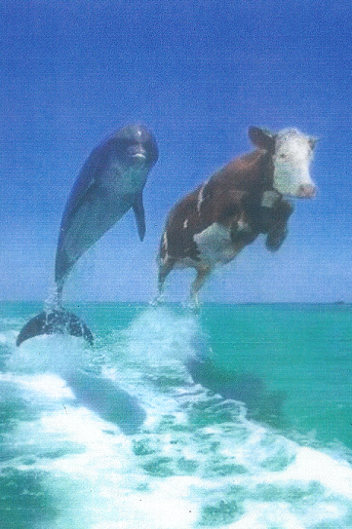

Slide 41
Secondary Losses –
Examples of the Loss of a Spouse
friend
provider
handyman
cook
lover
bill payer
gardener
laundry person
companion
confidante
sports partner
mentor
checkbook balancer
prayer partner
mechanic
source of inspiration or insight
identity

Slide 42
Secondary Losses –
Examples of the Loss of a Spouse
teacher
motivator
counselor
business partner
protector
errand person
organizer
encourager
in-law support
couple’s class
financial adjustment
social adjustment
feeling of safety
tax preparer
couple friends

Slide 43
The Eleven Major Losses of Life
Experienced Learned
1. Real or material
2. Abstract
3. Imagined
4. Relationship
5. Intra psychic
6. Functional
7. Role
8. Systemic
9. Threatened
10. Ambiguous
11. Disenfranchised

Slide 44
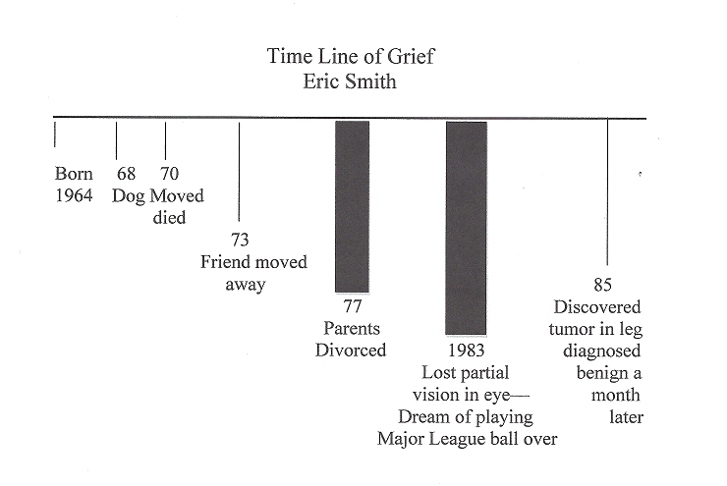
Time Line of Grief - Eric Smith

Slide 45
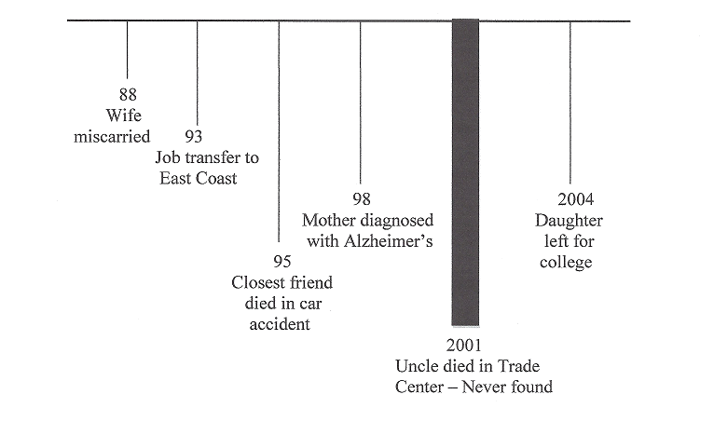
Time Line of Grief - Eric Smith

Slide 46
Janice’s Graph for Ten-Year-Old Jean
First Memory
Disneyland
0 3 4 5 7 8 10
New
School
Grandpa Hamster
Died Died Broken Arm
Couldn’t Play Soccer

Slide 47
Jean’s Graph
First Memory5
0 3 4 10
Hamster
Died
New
School
Broke
Arm
Grandpa
Died
Couldn’t Go
To Grandpa’s
Cabin
Lost Toys
Grandpa
Gave Her
A Boy She
Liked Doesn’t
Like Her
Wasn’t Allowed
To Attend Funeral
Two Friends
Stopped
Calling

Slide 48
Case Study
The parents as well as three siblings of a twenty-three-year-old woman came in for grief counseling. All were neat, well dressed and fairly quiet. The parents were first to speak about their daughter. They began with a description which characterized her as a quality young woman, their first born in the family. She was gifted in every area of her life and had a bright future ahead of her.

Slide 49
Case Study
The parents went into great detail about her abilities and accomplishments, stopping every now and then because of their inability to talk. Often all five were in tears. Two weeks prior she and her seven-month old unborn child and her mother-in-law were driving on a freeway when a truck struck and killed all of them. Since that time every member of this family has been struggling.

Slide 50
Case Study
Questions
1. How would you begin this session? Describe your exact words.
2. What would be your goal in this initial session?
3. What would you say or ask to engage the three siblings?

Slide 51
Case Study
4.What would you want them to take away from this session in a tangible way?
5. Based on this information identify all the possible grievers.
6. What are the factors which contribute to this loss being a complicated grieving process?

Slide 52
Case Study
1. After greeting each person I would validate the fact they have experienced a great loss in their life. If I didn’t know already I would ask the name of the daughter as well as the mother-in-law and whenever I made reference to either I would use their name rather than refer to them in a general way. One of the first questions I ask is, “Tell me about (the daughter) and have each of the family respond.

Slide 53
Case Study
Too often children are left out of the interaction. After each has responded my next question is, “Would you describe for me what the last two weeks has been like” so each has a chance to tell their story. Within this I often ask how they heard the news and to describe their reaction.

Slide 54
Case Study
2. My goal is to have them tell their story and then normalize for them what they are experiencing and educate them about grief and what to expect in the future (using the handout on the “Crazy Feelings of Grief”). I’d also want to find out about their support system as well as giving some suggestions to eliminate the pressure of other individuals.

Slide 55
Case Study
I also mention that each of them may grieve in a different way and with a different intensity. That’s all right and it’s not a sign that the other person doesn’t care if their grief is less intense. I ask, “How can the other family members support you at this time?”

Slide 56
Case Study
3. Some of the questions directed toward the parents could be asked of the siblings. I also let everyone know that I would be willing to meet with each one individually. One reason for this is the deceased was described as a “special gifted” individual but was she in the eyes of the siblings? Sometimes even in the initial session I ask for a favorite memory from siblings.

Slide 57
Case Study
Some may have a mixture of feelings. At some point I would ask the parents and siblings alike if there was any unfinished business or issues between them and the deceased or if there was something they wished they could have said to her before she died. If so, I would suggest writing a detailed letter and reading it aloud at the place of internment.

Slide 58
Case Study
4. I would like each one to believe there will be help for all of them during the months and years ahead of them. Any suggestions or recommendations made need to be put in writing such as the list of “Crazy Feelings of Grief,” etc. I would give each one a copy of Experiencing Grief as well, and suggest they read it when they’re ready.

Slide 59
Case Study
I also let them know that it is normal not to remember what they read at this time. I send home a DVD called Tear Soup and ask them to watch this together.

Slide 60
Case Study
5. There are two other family members who were lost as well. It would be easy to ignore them and gloss over this loss. I would ask about them as well as the effect this loss is having. For the parents, the loss is a grandchild which is major.

Slide 61
Case Study
The possible grievers would include husband, aunts, uncles, cousins, friends, fellow workers, pastors, church, ob gyn, husband’s family, grandparents, truck driver, and similar group of individuals. It’s important to consider who will minister to them and how.

Slide 62
Case Study
One of our tasks is to identify neglected grievers and reach out to them as well. Sending or giving them Experiencing Grief as well as making available copies of Tear Soup has been helpful.

Slide 63
Case Study
6. Not only was this a sudden death but it was multiple tragedy involving someone’s child and unborn grandchild. There could be the possibility of legal complications because it was a vehicular accident. The way in which the notification was made could be a factor as well. (Refer to the section on sudden death for additional information).

Slide 64
A Biblical Perspective
Peter said, “Beloved, do not think it strange concerning the fiery trials which try you, as though some strange thing happened to you”
(I Peter 4:12, NKJV)

Slide 65
A Biblical Perspective
The Message translation puts it in a unique way: “Friends, when life gets really difficult, don’t jump to the conclusion that God isn’t on the job. Instead, be glad that you are in the very thick of what Christ experienced. This is a spiritual refining process, with glory just around the corner.”

Slide 66
A Biblical Perspective
A Biblical perspective – Purpose of Loss
“Consider it all joy, my brethren, when you encounter various trials, knowing that the testing of your faith produces endurance, “ James 1:2,3

Slide 67
A Biblical Perspective
Consider or Count means:
An internal attitude or heart and mind that causes the trial and circumstance of life to affect us either beneficially or negatively.
Verb tense here means decisiveness of action – not passiveness.
Could mean "make up your mind to regard adversities as something to welcome or be glad" attitude.

Slide 68
2 Corinthians 1:3-4, AMP
Blessed [be] the God and Father of our Lord Jesus Christ, the Father of sympathy (pity and mercies) and the God [Who is the Source] of every consolation and comfort and encouragement; Who consoles and comforts and encourages us in every trouble (calamity and affliction), so that we may also be able to console (comfort and encourage) with which we ourselves are consoled and comforted and encouraged by God

Slide 69
The Purpose of Loss
A. Loss can strengthen our faith.
B. Loss can produce maturity.
C. As we suffer we enter into the suffering of our Lord and become more Christ-like
D. When you experience loss you will discover the extent of the comfort of God.
E. God can use what you’ve experienced to help someone else.

Slide 70
Georgianna

Slide 71
How to Help the Family
The following are additional suggestions as you work with family members, individually or corporately. If you were a medical doctor, your patient would not be an individual; it would be the family. It’s the same for us as well.

Slide 72
How to Help the Family
First, you need to get to know this family as well as the culture of the family if they are a different culture background than you, talk to others to learn some of the distinctions of this culture. A friend of mine asks the family he’s working with, “What do I need to know about your culture that will help me help you at this time?”

Slide 73
How to Help the Family
Listen to each of the family members to find out what they know, imagine, feel and fear. Don’t assume that they understand all of your terms. Ask them questions to clarify what they know.
Remember that a family is a system, and it’s important to meet together. I do this when I’m conducting a debriefing in companies and organizations when they’ve lost a long-term employee to death.

Slide 74
How to Help the Family
We talk about the fact that this group of 10 to 20 individuals in the debriefing was his “work family,” and they’ve just lost a family member.. Those in the group concur, and it’s vital that I meet with the entire group and they listen to one another, as well as to what I have to say. At work, it’s just a larger system.

Slide 75
How to Help the Family
As you work with family members about the death of their loved one, ask about the person’s work. Have the family identify those people they are aware of at work. There are probably fellow workers who are impacted as much or more than the person’s own family. You may want to contact the deceased’s place of employment to offer your service at this time.

Slide 76
How to Help the Family
As you work with the family, attempt to build a relationship with each one. The more verbal ones will try to dominate your involvement. Remember that the quiet ones have as much to say as those who are outwardly verbal. They’re talking to themselves. It’s easy to neglect those who are quiet, as well as children. If you haven’t worked much with children, it would be helpful to expand your knowledge at this time.

Slide 77
How to Help the Family
Discuss their fears and concerns about death as well as being around someone who is dying. Involve everyone in the care and treatment of the dying person. There may also be some individuals, relatives or friends that the family would rather not have as visitors. Identify these people and offer some practical advice on how to keep them away. Prepare to encounter some surprises and unexpected intruders.

Slide 78
How to Help the Family
Help the family find a way to express and download their feelings after every visit. Perhaps they can talk or pray or write out what they’re experiencing for five minutes before they get in their car. Each person needs his or her own individual minor debriefing or the pressure will begin to pile up.

Slide 79
How to Help the Family
Caregiving would be draining. Help them anticipate how this experience will stretch their own coping skills and be exhausting. Help them develop a plan for maintaining energy. Parents who are losing their spouse and still have to care for their children are especially vulnerable. Teach them how to handle one at a time. Hopefully, your church will have some trained caregivers who can assist at this time.

Slide 80
How to Help the Family
If you are working with more than one family unit, be sure to activate your flexibility and what you say and do for each family and person. What do you know about death and dying? What have you seen and experienced? Note that one of your tasks may be to educate the various family members, from children to adults, about death and dying.

Slide 81
How to Help the Family
This can include what is anticipatory grief as well as what can be expected at the time of death or afterwards. They may also need assistance in finding resource materials, and financial and social assistance. Discuss their support network; and if there isn’t any network, assist them in creating one.

Slide 82
How to Help the Family
Talk with them about those things they are hesitant to talk about it. Some may feel guilty about planning the future without the person, or how this is affecting finances and the pressure of “who gets what” after the person is gone. If you see this issue, you can say, “Often families struggle in talking about certain topics such as . I wonder if this has been the case for any of you.”

Slide 83
How to Help the Family
Help the family members to know how to respond to the dying person. Encourage them to let the loved one know what he or she has meant to them and how this person will be remembered.
Help them retain some level of optimism. “It’s true that is dying, but how can you make the most of the time you have left together?”

Slide 84
How to Help the Family
One of the difficult times is when it appears the death is about to occur and, on his or her own, the person rallies and recovers, and then this pattern occurs several times. This can put the family on an emotional roller coaster.

Slide 85
How to Help the Family
Family members may wonder if their responses are normal since they may detach as a means of protection of their own loss. On the other hand, they may feel abandoned because the dying person will withdraw and detach since that is a part of the dying process.

Slide 86
How to Help the Family
Help the family mourn together in a supportive way.
One last suggestion has to do with you and your own personal debriefing. You may be impacted by what you hear and see, so it’s important for you to express and download your own feelings and grief that you experience in helping others.

Slide 87
How to Help the Family
Talk with a trusted friend, write out your experiences, and pray. Remember that you, too, need others in your life in order to effectively minister to others.

Slide 88
How to Help the Family
One specific intervention is to have each family member write about what life was like with the deceased person and how life has now changed with this person’s death. You might invite each one to draw a large circle on a piece of paper. Then have them divide the pie to illustrate the various roles they occupied prior to the death of his or her loved one (including the role with the deceased and all its manifestations).

Slide 89
How to Help the Family
The size of each piece should correspond to the percentage of importance and the amount of time allocated to that role played in his or her life. Once they have completed the assignment, use the pie chart to discuss more fully the may facets of the role he or she fulfilled in the deceased’s life before the death in contrast to how those roles may have changed subsequent to the loved one’s death.

Slide 90
How to Help the Family
Encourage them to explore how that empty piece of the pie might be filled as more is learned about how he or she is without the loved one.

Slide 91
How to Help the Family
Another helpful exercise is to ask each family member to write a list of both interests and activities they have pursued within approximately the last 10 year, indicating as well their level of interest in those activities as compared with the person who died. This may help the bereaved family to develop a clearer sense of their own personal interests dependent of the influence of the deceased person.

Slide 92
How to Help the Family
Have an adult person draw a genogram of the existing extended family to examine the nature of their current relationships and what their expectations might be for those relationships in the future. Death obviously changes dynamics in relationships—some of the changes are painful, but other relationships may grow close and more meaningful.

Slide 93
How to Help the Family
The bereaved person may also become aware of he need for additional friendships or more diversity in relationships.
With his or her name on the innermost circle (the bull’s-eye), invite them to add the names of people who would be the next most intimate in the second circle, the third most intimate in the third circle, and so on.

Slide 94
The Crazy Feelings of Grief
The “crazy” feelings of grief are actually a sane response to grief. The following examples are all symptoms of normal grief:
distorted thinking patterns, “crazy” and/or irrational thoughts, fearful thoughts
feelings of despair and hopelessness
out of control or numbed emotions

Slide 95
The Crazy Feelings of Grief
changes in sensory perceptions (sight, taste, smell, etc.).
increased irritability
may want to talk a lot or not at all
memory lags and mental “short-circuits”

Slide 96
The Crazy Feelings of Grief
inability to concentrate
obsessive focus on the loved one
losing track of time
increase or decrease of appetite and/or sexual desire
difficulty falling or staying asleep

Slide 97
The Crazy Feelings of Grief
dreams in which the deceased seems to visit the griever
nightmares in which death themes are repeated
physical illness like the flu, headaches or other maladies
shattered beliefs about life, the world, and even God

Slide 98
Sleep
When you lie down you shall not be afraid; yes, you shall lie down and your sleep shall be sweet. Be not afraid of sudden terror and strong, nor of the stormy blast or the storm and ruin of the wicked when it comes [for you will be guiltless], For the Lord shall be your confidence, firm and strong, and shall keep you foot from being caught [in a trap or hidden danger].
Proverbs 3:24-26, AMP

Slide 99
Sleep
You will not be afraid when you go to bed and you will sleep soundly through the night. Psalm 3:5, Good News Bible
If I’m sleepless at midnight, I spend the hours in grateful reflection. Psalm 63:6, The Msg
When my anxious thoughts multiply within me, Your consolations delight my soul. Psalm 94:19
I will lie down and sleep in peace, for you alone, O Lord, make me dwell in safety. Psalm 4:8

Slide 100
Sleep
In a dream, a vision of the night
When sound sleep falls on men,
Then He opens the ears of men,
And seals their instruction. (Job 33:15-16).

Slide 101
Dear God,
We give thanks for the darkness of the night where lies the world of dreams. Guide us closer to our dreams so that we may be nourished by them. Give us good dreams and memory of them so that we may carry their poetry and mystery into our daily lives
Grant us deep and restful sleep that we may wake refreshed with strength enough to renew a world grown tired.

Slide 102
We give thanks for the inspiration of stars, the dignity of the moon and the lullabies of crickets and frogs.
Let us restore the night and reclaim it as a sanctuary of peace, where silence shall be music to our hearts and darkness shall throw light upon our souls. Good night. Sweet dreams. Amen
Michael Leuing A Common Prayer

Slide 103
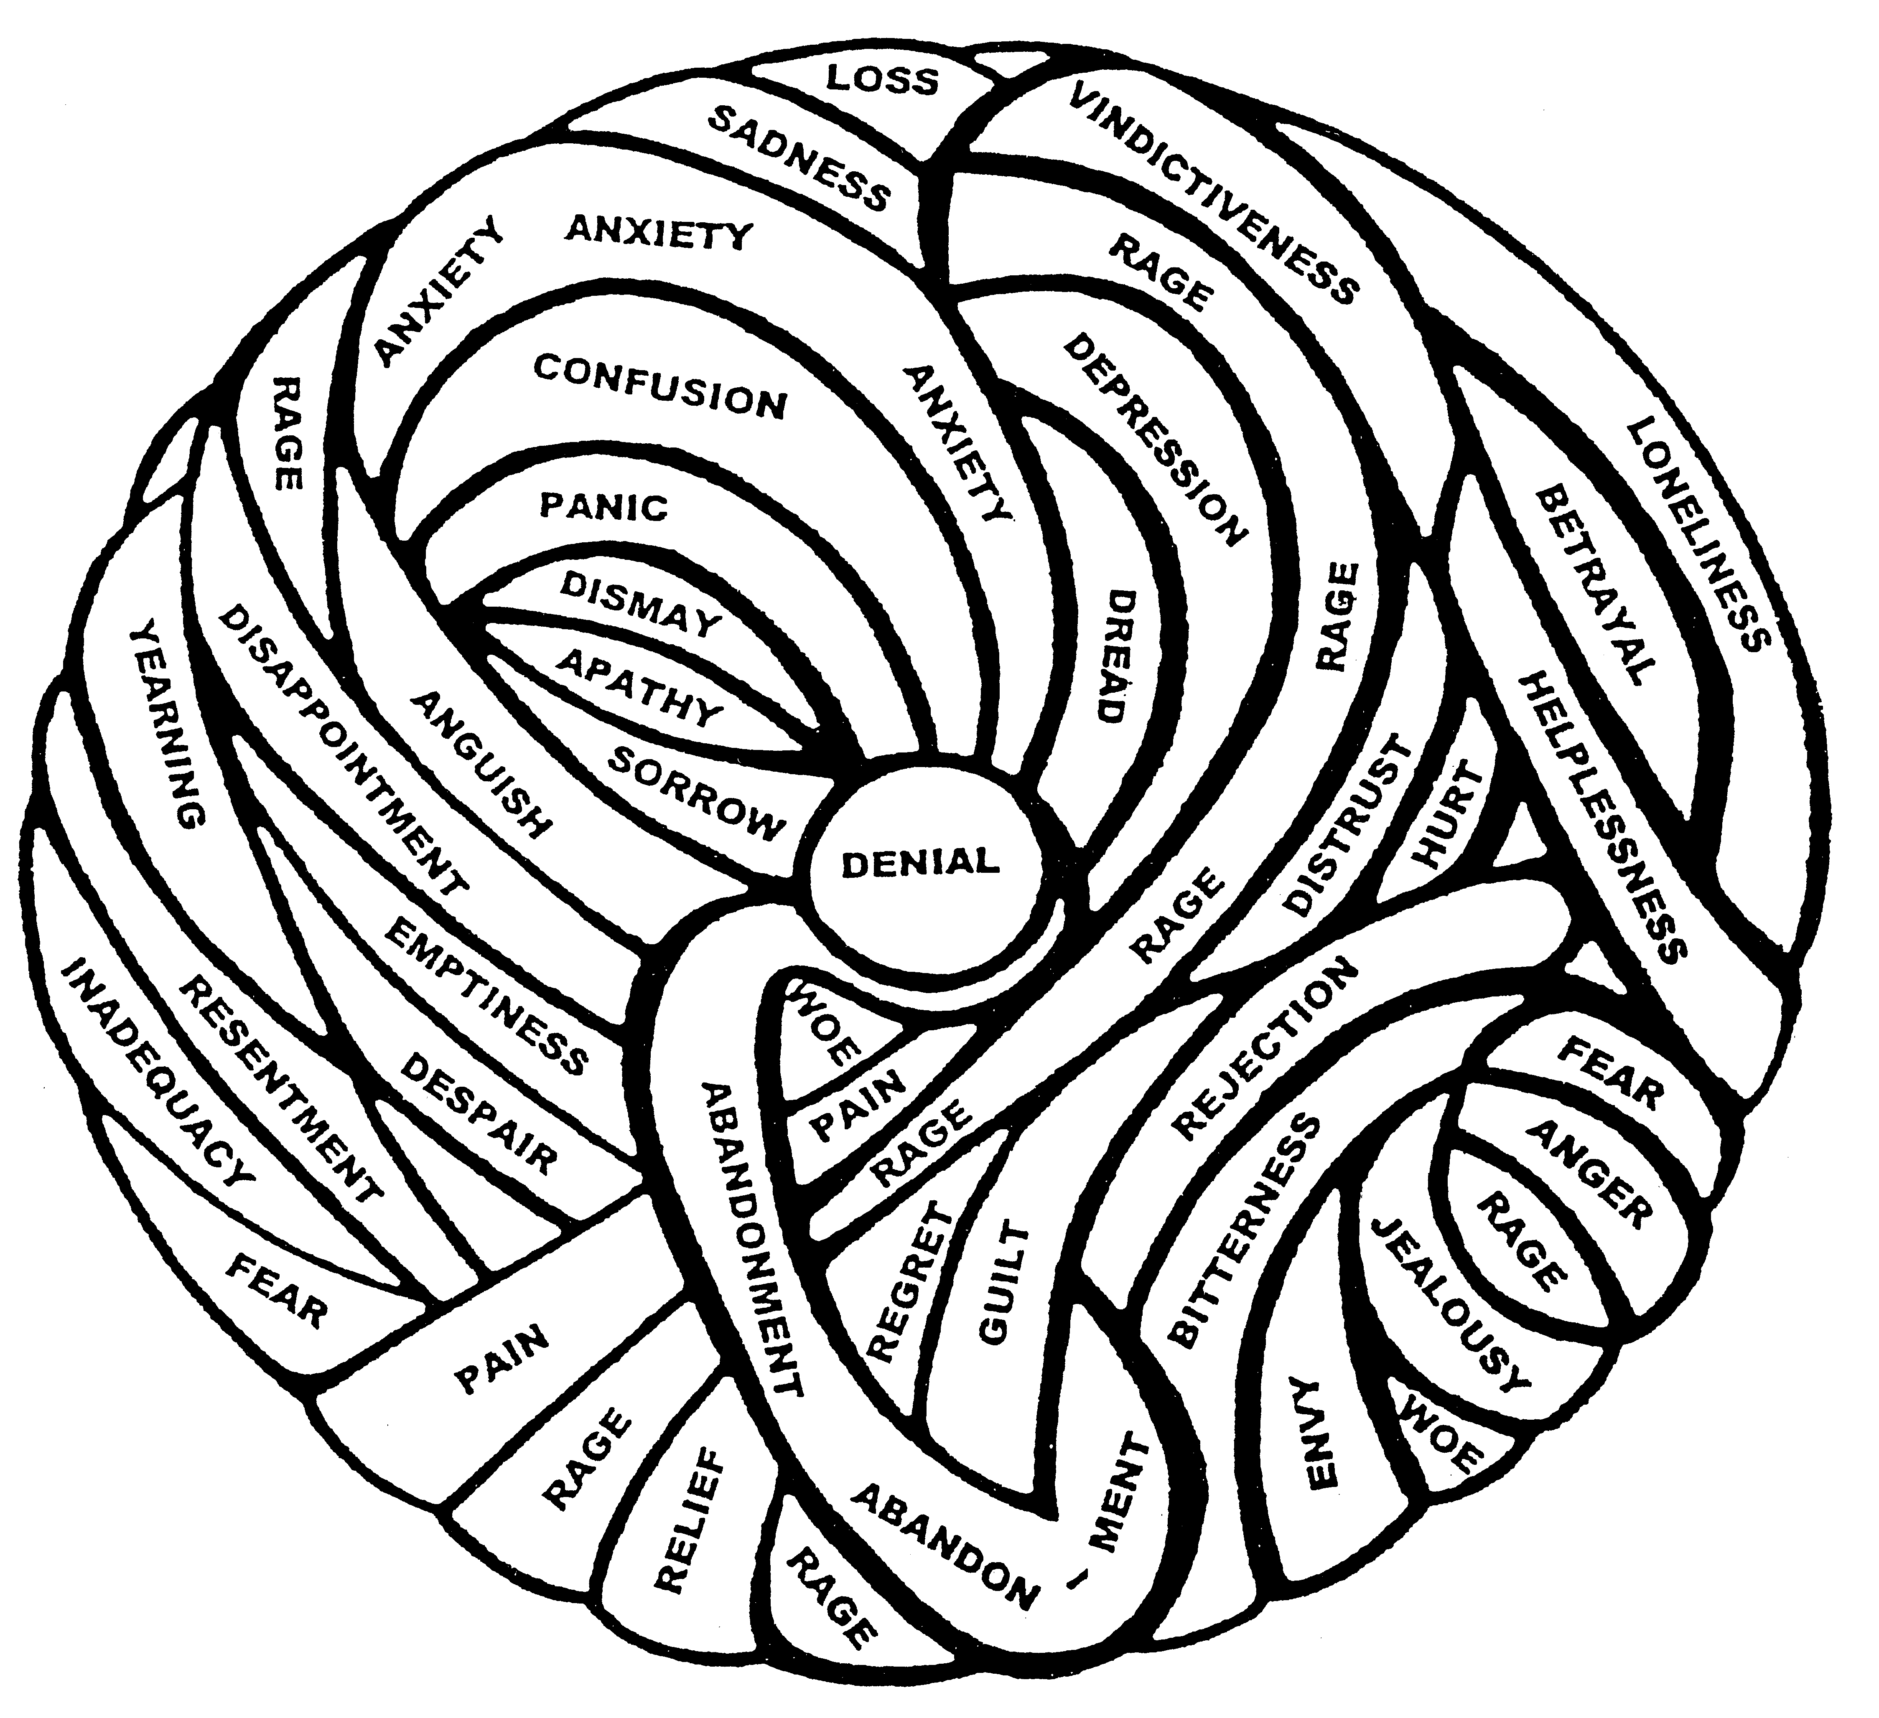
Use the Ball of Grief

Slide 105
Bad Day/Good Day Exercise
Bad Day, Good Day exercise. Give your client a piece of paper and a pen, and ask them to divide it into two columns. At the top of the left hand column, write ‘When I have a bad day i…’’ and the top of the right hand column, write “When I have a good day, I…”

Slide 106
Bad Day, Good Day Exercise
Ask them to list as many of the things they experience under each of the headings. You can use these lists to help them think about the ways they manage their bereavement.

Slide 107
Bad Day, Good Day Exercise
You can ask questions like:
“What sort of pattern is there to these ‘days’?”
“How long in between the ‘days’ do you find there is?”
“What sort of things can send you into a ‘bad day’?”
“How do you get out of a ‘bad day’?”
Take from Dodie Graves, Talking with Bereaved People

Slide 108
WHEN TIME DOESN’T HEAL ALL WOUNDS
Trauma

Slide 109
“The sadness will never go away.”
Vincent Van Gogh

Slide 110
I am frightened inside; the terror of death has attacked me. I am scared and shaking, and terror grips me. I said, “I wish I had wings like a dove. Then I would fly away and rest. I would wander far away and stay in the desert. I would hurry to my place of escape, far away from the wind and storm.”
Psalm 55:4-8 New Century Version
How long must I wrestle with my thoughts and everyday have sorrow in my heart?
Psalm 13:2, NIV

Slide 111
The Common Themes of Trauma
It can strike anyone
Trauma leaves us feeling unsafe
It involves a loss
Trauma makes us feel overwhelmed
It is often unspeakable
Trauma can change or challenge our
view of God

Slide 112
The Common Themes of Trauma
Trauma produces “hyper-arousal,” “hyper-alertness” and “hyper-sensitivity.”
Those traumatized often re-experience the trauma
It leads to feelings of helplessness
Trauma does not make sense

Slide 113

DEFINITION OF TRAUMA
“Trauma is the response to any event that shatters your safe world so that it is no longer a place of refuge. Trauma is more than a state of crisis. It is a normal reaction to abnormal events that overwhelm a person’s ability to adapt to life—where you feel powerless”

Slide 114
What Is Trauma?
Trauma is the response to any event that shatters your world.
It’s more than a state of crisis. Trauma leaves you feeling unsafe because your place of refuge has been invaded
The word trauma comes from a Greek word that means “wound.” It’s a condition characterized by the phrase “I just can’t seem to get over it.”

Slide 115

TRAUMA: WHAT IT DOES
“Trauma creates chaos in our brain and causes an emotional as well as a cognitive concussion”

Slide 116
Trauma: What’s it Like?
Memory lapses.
Can’t distinguish real from false threat.
Verbal deficits.
Hyper-startle response.
ADD.
Gotta go.

Slide 117

TRAUMA: TRIGGERS
Anniversary.
Holidays.
Family events.
See, hear, smell, tastes.
Court.
Police.
Mental health.
Sentencing
Media.
Movies.
Bagpipes.
TAPS.

Slide 118
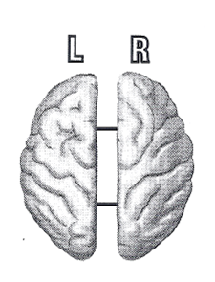

Slide 119
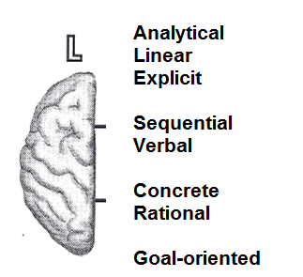
The Human Brain

Slide 120
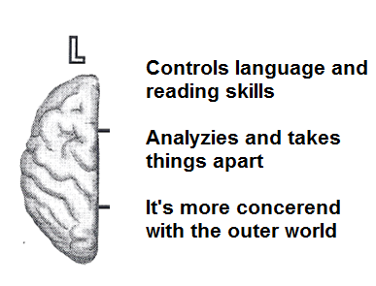
The Human Brain

Slide 121
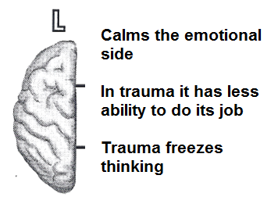
The Human Brain

Slide 122
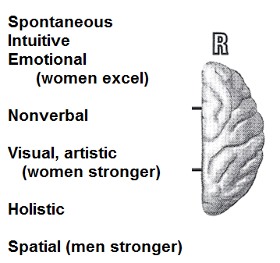
The Human Brain

Slide 123
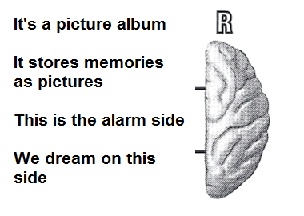
The Human Brain

Slide 124
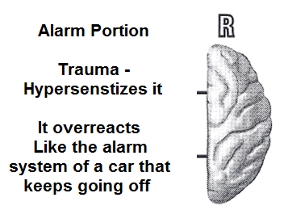
The Human Brain

Slide 125
The Right Side
This is where Post Traumatic Stress Disorder (PTSD) pictures come from. And traumatic memories is like a series of snapshots or a silent movie. There is no music or words. In counseling you want to put words and music to the pictures.

Slide 126
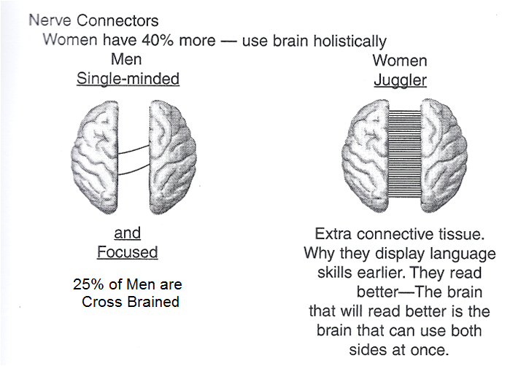
The Human Brain

Slide 127
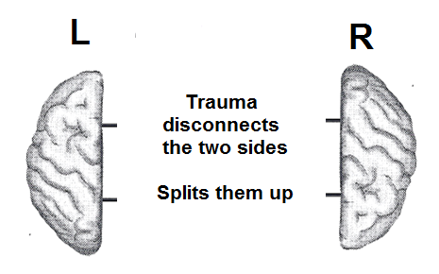
The Human Brain

Slide 128
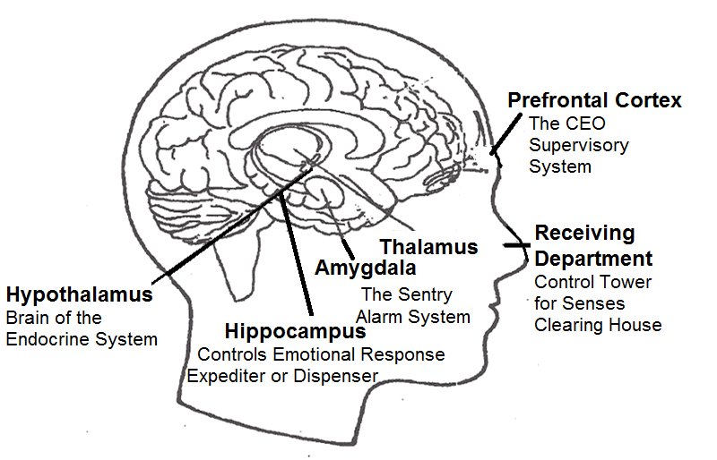
The Human Brain

Slide 129
Worst is Over
This is the first book of its kind written with everyday people in mind. It details the methodology designed for talking to the autonomic nervous system to evoke a desired change. It provides the means for people to help each other through medical emergencies, as well as through emotional and chronic illness and pain, using the one skill we all share, no matter what level of medical training we have—the ability to communicate.

Slide 130
Worst is Over
We have seen the power of words first hand , in our practices and in our trainings, in our offices and on the streets. We have seen children stop bleeding, the chronically ill develop a remarkable tolerant to pain, and elderly patients in respiratory distress return to easy healthy breathing.

Slide 131
Worst is Over
“The worst is over for now. We are taking you to the hospital. Everything is being made ready. Let your body concentrate on repairing itself and feeling secure.”

Slide 132
Worst is Over
A person attending another person in crisis has three verbal options. We can:
Say nothing
Say something harmful
Say something helpful that promotes healing

Slide 133
Worst is Over
It may be helpful to speak into the left ear to more readily access right brain involvement.
“My name is Norm and I’m here to help you. The worst is over for now. You can take comfort in knowing that the worst is over and the paramedics are on the way. You can be comfortable and use everything you’ve got to survive and start healing now.

Slide 134
Worst is Over
I’m sure you will want to listen to what I say and do as much as you can to help me help you.”
Where was the contract? In the word can. The man was given permission. The choice was his. As we’ve seen, people who are unconscious can still hear what is being said and done around them.

Slide 135
Worst is Over
Bobby is six years old and his arm is stuck in a broken wall in a construction site. A firefighter, Captain McMann, is on the scene.
“Hi. What’s your name?”
“Bobby.” (He is crying and afraid).

Slide 136
Worst is Over
“Well, Bobby, I’m Captain McMann and I’m a fireman and I’m here to help you. Now I’m going to need your help. …Have you ever seen a rescue on TV? (Yes or No). Well, I’d like you to be my partner here today, because you know best where I can help you. You can be my partner today, can’t you?
Bobby agrees, and becomes calm enough to fallow Captain McMann’s directions so that he can be freed.

Slide 137
Worst is Over
Or, with adults…
“I’m Captain Peters with the Emergency Rescue Team. I’m here to help you. The best way to accomplish this is for you to help me. Can I count on you? Will you help me help you? You can just nod or signal me with your hand. I need you to scan your body in your mind and tell me what parts of your body need my attention.”

Slide 138
Worst is Over
Gaining Rapport with Adults
Establish an Alliance
“I’m and I’m going to help you.”
“I’m here to help.”
“It’s okay. I’m here.”

Slide 139
Worst is Over
Get a Contract
“Will you do what I say?”
“Will you come with me?”
“Will you help me to help (your arm/let etc.) feel better?”

Slide 140
Worst is Over
Be Realistic
“The fire is out.”
“The danger is past.”
“The worst is over.”
“I see what’s happening here.”

Slide 141
Worst is Over
When you come upon someone in an emotional crisis, the same techniques you learned for medical emergency apply.
Getting a Contract: “I’m here to help you… will you do as I say?”

Slide 142
Worst is Over
Soliciting Their Help: “As I get you some water, will you count your breaths for me, watching them slowing down?” “Tell me everything you think I should know so I can help you feel safe now.”
Distraction: “Come, walk with me over here, so I can help you better…that’s right…and, as you do, keep holding my hand just like that, tight, keeping all your attention on my hand and your hand…”

Slide 143
Patterns of Grief
Some individuals are intuitive grievers. For them:
Feelings are intensely experienced. They want and need to express them.

Slide 144
Patterns of Grief
Some individuals are instrumental grievers.
They think of their grief more than feel it: Feelings are less intense.

Slide 145
How We Can Help
The three most important steps to take in helping a person:
1). Listening with your eyes
2). Listening with your ears
3). Listening with your heart
James 1:19: Prov. 18:13

Slide 146

THE IMPORTANCE OF LISTENING
“Everyone must
be quick to hear,
slow to speak….”
(James 1:19, HCSB).

Slide 147
Death of a Spouse
Was it an anticipatory loss, crisis or trauma?
Delayed Grief - Because of children or work
Support – The Ten Day Syndrome

Slide 148
Death of a Spouse
Major Problems
Secondary Losses
Financial
Holiday
Significant Dates
Death of an ex-spouse

Slide 149
What to Do
1. First finances
2. List the essentials and the non-essentials
3. List what I know how to do and what I don’t
4. Help them handle the advice of others
5. Help them handle the holidays
6. Explanation letter – Change monthly or quarterly

Slide 150
What to Do
7. Identify safe people
8. Set up a team of people – Different each month
9. Handle the feelings
10. Help them learn to live “without”
11. Develop a new relationship
What will you continue do to and what will change?
12. Secondary losses

Slide 151
What to Do
13. Journals
Helpful Suggestions
Begin journaling about your deceased spouse by responding to the following questions:
What do I miss most about my spouse?
What do I wish I had asked or said to my spouse?

Slide 152
What to Do
What do I wish I had done or not done?
What do I wish my spouse had said or not said?
What did I value most about our relationship?
What was hurtful or angering about our relationship?

Slide 153
What to Do
What special memories do I have of my spouse and what memories will I keep alive?
What will I take with me as a part of my spouse and our relationship to cherish?
What living situation is difficult to deal with now without my spouse?

Slide 154
What to Do
14. A “Letting Go” prayer
Help them say goodbye
15. Watch out for premature relationships
16. Determine who you are now
Who am I by myself?
Who am I right now?
Where do I want to be?
What do I want for myself out of life?

Slide 155
“You turned my wailing into dancing; you removed my sackcloth and clothed me with joy, that my heart may sing to you and not be silent. O Lord my God, I will give you thanks forever” (Ps. 30:11-12)

Slide 156
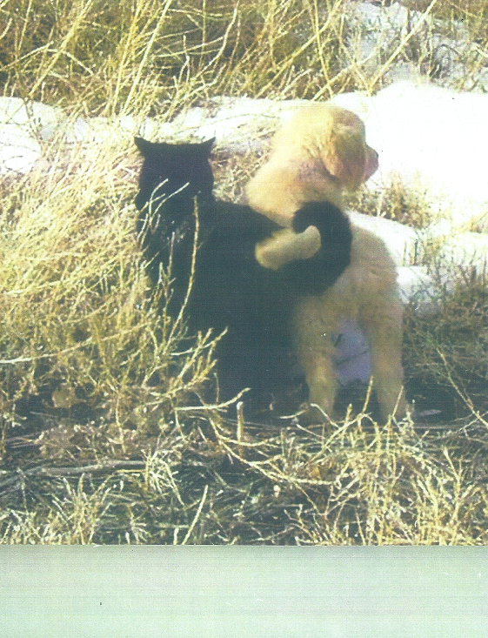

Slide 157
Eve
Counselor: I’ll let you begin where you’re comfortable, Eve.
Eve: This is a bit of a recent loss. (pause) In November, November 5th I lost a very, very close friend. It was from the swine flu. It was a very sudden loss, unexpected. And we had recently had a disagreement. So I blame myself. Somehow I felt responsible, so that made it harder, because I wasn’t there to encourage proper medical care and that sort of thing. (speaking slowly and softly)

Slide 158
Eve
Counselor: So you’re taking on some real responsibility for this person’s death.
Eve: Yes…yes
Counselor: And what was this person’s name.
Eve: His name was Warren.
Counselor: Warren

Slide 159
Eve
Eve: And they didn’t go to the doctor soon enough and I felt like that was the reason that he died. So it’s been very difficult. I can’t… I know logically I’m not responsible, but internally I was thinking, I keep telling myself, “If only this…” I reenacted making contact in time to say, “Oh, are you sick? You should go to the doctor.”
Counselor: So your mind is telling you one thing, but your heart seems to be overriding that and you’re taking on that responsibility? (tentative)
Eve: I am

Slide 160
Eve
Counselor: And when you reenact this in your mind, how does that leave you?
Eve: Oh, I feel terrible. I feel so guilty, I feel lost and sad. I started to get migraine headaches. I realized was punishing myself each time I’d think it.
Counselor: How long did you know Warren?
Eve: Probably 32 years

Slide 161
Eve
Counselor: So it was a long relationship
Eve: A long friendship…very long friendship. Very long (voice trails off)
Counselor: And you’re thinking if we haven’t had this riff then I could have saved him.

Slide 162
Eve
Eve: Right, I had tried to get back in touch but by then I didn’t know he was sick. I actually heard about it accidentally. Someone who knew I knew him said, “You know Warren’s in ICU how’s he doing?” I said, “Oh, I don’t know.” I was in shock, I couldn’t believe he’d had been there for 17 days before I heard. And he was all alone during his illness part. So, waited to go to the doctor to the last minute to go to the doctor and it was too late.
Counselor: You’re thinking I could have prevented this from happening.

Slide 163
Eve
Eve: Yeah, I think that over and over and over. And I know he probably wouldn’t have even listened to me. He was a very stubborn person, very stubborn because his son was living with him and he wouldn’t listen to anybody.
Counselor: So there were other people who probably encouraged him to go to the doctor.
Eve: Probably
Counselor: But he didn’t listen to them.

Slide 164
Eve
Eve: Well, actually just his son. He never let anyone at work know how bad he was, how sick he was. They just kept thinking he would be coming back next week. One of his co-workers she felt guilty too because she was with him when she dropped him off and she knew how sick he was. But she didn’t have the kind of connection with him that she would call. Well, she got sick herself from the swine flu. And it’s been since November, it’s a little better, but suddenly it will come over me.
Counselor: It’s still heavy on your heart.

Slide 165
Eve
Counselor: It’s still heavy on your heart.
Eve: It’s so heavy, it’s so painful
Counselor: But you’re not certain he would have listened to you.
Eve: No, honestly I know he probably wouldn’t have. He’s very stubborn about going to the doctor about anything.
Counselor: Like many men

Slide 166
Eve
Eve: Yes, like many men (smiles)
Counselor: But still because of that connection you just wish, “I could have done something to help him.”
Eve: I feel so helpless. This is the worst part though. I never say anything to somebody. He had sort of a sharp way of saying things. It was part of him, everybody knew that. And I never said anything back. And this one time it was over something stupid. He made a comment about my car. I carry all my files. And he made some comment. And I said, “I don’t ever want to talk to you.” But it was a lot of things. I said, “I don’t want to talk to you anymore.” It hurt my feelings.

Slide 167
Eve
Counselor: It sounds like it was a build up, it wasn’t just what happened then.
Eve: So I said, “I never want to talk to you again.” I didn’t really mean it because I never say that to anyone. But then I thought he probably really believes it. So, then I was afraid to call him back. We didn’t speak ever again. It was so hard. I feel like he left the earth thinking and I never wanted to talk to him again. He was such a good friend.

Slide 168
Eve
Counselor: You had a lot of good times together.
Eve: We worked in a lot of different places together. He was a very great person. Just didn’t like to go to the doctor. I felt so helpless.
Counselor: It sounds like you still have some things you’d like to say to him. Have you written him a letter?
Eve: No, I haven’t. It’s an idea.

Slide 169
Eve
Counselor: Do you think it would help?
Eve: Yeah, I think it would.
Counselor: If you were to write it, what would you do with it?
Eve: Oh, I’d probably would read it out loud. That would probably help.
Counselor: Where would you read this?

Slide 170
Eve
Eve: I just heard they are getting ready to get his headstone ready. Maybe I could read it at his grave. It’s funny because I’ve been thinking about what to do to go there what would I do? In Judaism you leave stones to show that you have been there. And I was reading about it last night you know like an altar. I have a stone from Israel. It’s a tradition that comes from many different places. And I have a stone that I have from when I went to Israel. He always said he wanted to go to Israel for the history. He didn’t have any belief system at all, in God. (takes a Kleenex) That would be a healing thing to read the letter.

Slide 171
Eve
Counselor: What would you like to say?
Eve: Just to thank him for being such a good friend. To tell him I miss him and that a lot of people miss him. He such a beloved person. To tell him I wish he hadn’t been so stubborn, but we know that was who he was. Just to put those feelings into words, give words to those feelings.
Counselor: Churning. They’re churning around a lot inside of you, aren’t they?

Slide 172
Eve
Eve: Just even talking I feel some relief. They come back. It’s seems that they come back all of a sudden.
Counselor: You also alluded to regrets. I wonder what you could do about the regrets.
Eve: Well I think the one thing was the regret. I rarely even speak to somebody if they have a bad temper - I think I won’t talk to them for a while. And I thought to make sure I never leave a friend without making sure that we’re still connected. Never say I won’t ever talk to you again. I don’t know why I said that.

Slide 173
Eve
Counselor: This is becoming sort of a learning experience?
Eve: To learn how important every moment is. And not to lose a chance to do some healing. And to make sure we reconnect with each other even when we’ve been upset in a moment. Never walk away from anyone whether I care about them or not, like Warren. Every person is important who comes in my path. I don’t want to ever regret the thing about words. Not to put words out that are going to hurt. I do regret that. Because you don’t know if you’re ever going to see that person again. You just don’t know!

Slide 174
Eve
Counselor: And you really don’t fully know how he felt toward you after that either. I guess we all tend to assume the worst.
Eve: Oh, yes.
Counselor: Can you think of anything else you might be able to do that can help you at this time?

Slide 175
Eve
Eve: I think talking about this here and writing the letter. I need to reconnect with the woman who was with him when he got ill because she carried so much guilt, too because she didn’t go back and reconnect with him.. We’ve formed a bond and friendship together and because of that we can both share together. That’s been very helpful.

Slide 176
Eve
Counselor: The situation itself where you had the altercation with him, does it play over sometimes in your mind?
Eve: Yes.
Counselor: I imagine when that happens it’s still pretty upsetting.
Eve: It still hurts

Slide 177
Eve
Counselor: What do you think about writing that out in detail in longhand?
Eve: Oh, I hadn’t thought of that. I have such rare altercations… Yeah, that would be good because it’s painful to think about.
Counselor: Sometimes those thoughts get stuck on a circular loop and they keep playing. And one of the best ways is just best to write it.

Slide 178
Eve
Eve: I like that idea. (pause) Yes, that would be good.
Counselor: Can you think of anything else you might be able to do?

Slide 179
Eve
Eve: Well, one of the things I am doing - that’s why I’m taking this class because I want to be able to help others. I’ve counseled for a long time but feel like I went right through the fire with this loss. I lost my dad 11 years ago, that was hard and I’ve had the miscarriages, that was hard. Maybe part of this is I’m feeling I should have known. I’m mad at myself as a counselor, I should have known to do this differently. Just to give myself permission to be human, not to expect myself to know everything when I’m in a situation like this.

Slide 180
Eve
  Counselor: To be a bit more accepting of yourself.
Eve: Forgiving. To find some forgiveness for myself that’s important
Counselor: Very important. And we know who does forgive us, don’t we? Well, thank you for being brave enough to sit here with us.

